Slide 1


RECAP OF PREVIOUS MEETING
GIT AND GITHUB

Slide 2
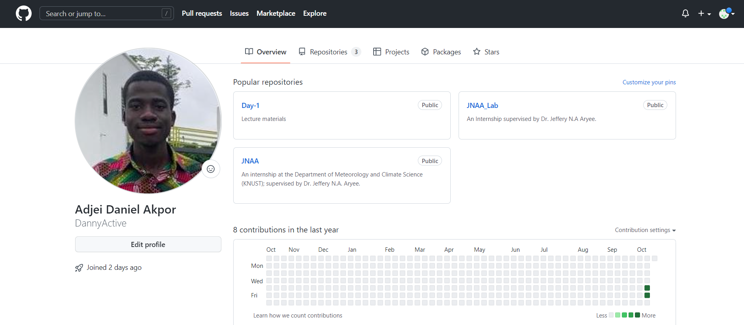
PROFILE EDITTING

Slide 3
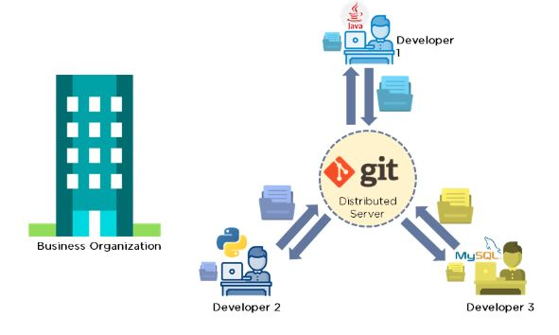
GIT & GITHUB
Git is a free open source code control management.
It allows one to track changes in source codes, allowing multiple developers to work together on a non-linear development.
Files in Git can be in any of the 3 stages: modified, staged, committed .
GitHub is a code hosting platform.

Slide 4

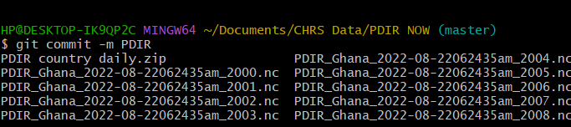

SOME COMMANDS
Specify name and Email
Set default branch name
Check git status
Commit files
For help

Slide 5


